Slide 1
NAME : K KISHORE
NM.ID : aut730321104303
REG NO : 730321104303
DEPARTMENT : CSE
YEAR : III
COLLEGE : BUILDERS ENGINEERING COLLEGE

Slide 2
EMOTION DETECTION

Slide 3


AGENDA
Introduction and Overview
Project Scope and Requirement
Data Collection and Preprocessing
Model Selection and Development
Integration and Deployment
Testing and Evaluation
Documentation and User Support
3/21/2024 Annual Review

Slide 4

PROBLEM STATEMENT
The objective of this project is to develop a robust and efficient emotion predictor that accurately anticipates the age and gender based on user input image. The predictor should seamlessly integrate into existing image-based applications and provide real-time suggestions to enhance user typing experience.
Key Challenges
Data Collection and Preprocessing
Model Selection and Training
Real-time Performance
User Engagement and Feedback

Slide 5

PROJECT OVERVIEW
You are tasked with developing a machine learning model to detect the emotion of individuals from facial images. This technology will be used in various applications, including targeted advertising, audience analytics, and customer segmentation.
You are provided with a labeled dataset of facial images, where each image is annotated with the corresponding emotion and expression of the individual depicted. The dataset contains a diverse range of images capturing individuals from different demographics, ethnicities, and age groups.
Objective:
Your objective is to build a robust machine learning model capable of accurately predicting the emotion of individuals from facial images.

Slide 6

WHO ARE THE END USERS?
The end users of the emotion predictor can vary across different images and applications. Here are some examples of potential end users:
Marketing and Advertising Companies
Market Research Firms
Social Media Platforms
Entertainment Industry
Security and Surveillance Systems

Slide 7

SOLUTION AND ITS VALUE PROPOSITION
Overview:
The emotion Predictor is an advanced machine learning system designed to accurately determine the emotion of individuals based on facial analysis. Leveraging state-of-the-art algorithms and deep learning techniques, the predictor provides real-time predictions with high precision and reliability.

Slide 8
Key Features:
Facial Analysis: Utilizes advanced facial recognition algorithms to extract key facial features such as contours, textures, and expressions.
Machine Learning Models: Employs Convolutional Neural Networks (CNNs) and other deep learning architectures to analyze facial features and make accurate predictions.
Real-time Prediction: Provides instantaneous predictions, enabling seamless integration into various applications and systems.
Scalability: Designed to scale effortlessly to accommodate large volumes of data and high-demand environments.
Customization: Offers customization options to tailor the predictor to specific use cases and requirements.

Slide 9

THE WOW FACTORS:
Near-Instantaneous Predictions: The predictor provides real-time predictions, delivering emotion results within milliseconds of analyzing a facial image. This lightning-fast response time impresses users and ensures seamless integration into various applications and systems.
High Accuracy and Reliability: With advanced facial recognition algorithms and deep learning techniques, the predictor achieves exceptional accuracy and reliability in emotion predictions. Users are consistently impressed by the precision of the results, leading to increased trust and confidence in the system.
Multi-Platform Compatibility: The predictor is designed to work seamlessly across multiple platforms and devices, including web applications, mobile apps, and IoT devices. Its versatility and compatibility with diverse environments wow users and expand its usability across different use cases.
3/21/20

Slide 10
MODELLING
Data Collection and Preprocessing:
Gather a dataset of facial images labeled with emotion like sad or angry information.
Preprocess the images to ensure uniformity and quality, including resizing, normalization, and augmentation techniques to increase dataset diversity.
Feature Extraction:
Use techniques like face detection and landmark localization to extract relevant features from facial images.
Consider techniques such as Histogram of Oriented Gradients (HOG), Local Binary Patterns (LBP), or deep learning-based feature extraction methods.

Slide 11
Model Selection:
Choose an appropriate machine learning or deep learning architecture for age and gender prediction.
For deep learning, Convolutional Neural Networks (CNNs) are commonly used due to their effectiveness in image-related tasks.
Model Training:
Split the dataset into training, validation, and test sets.
Train the selected model on the training set using an appropriate loss function and optimization algorithm.
Tune hyperparameters such as learning rate, batch size, and network architecture to optimize performance.
Model Evaluation:
Evaluate the trained model on the validation set to assess its performance.
Use evaluation metrics such as accuracy, precision, recall, and F1-score for both age and gender predictions.
Analyze the model's performance using confusion matrices and ROC curves.

Slide 12
Optimization and Fine-Tuning:
Fine-tune the model based on validation performance, adjusting hyperparameters and training strategies as needed.
Consider techniques like transfer learning, regularization, and ensemble methods to improve generalization and mitigate overfitting.
Model Testing and Deployment:
Test the final model on the held-out test set to validate its performance in real-world scenarios.
Once satisfied with the model's accuracy and robustness, deploy it into production environments for age and gender prediction tasks.
Monitoring and Maintenance:
Monitor the deployed model's performance over time and retrain as needed to adapt to changing data distributions or requirements.
Continuously update and improve the model based on feedback and new research developments.

Slide 13
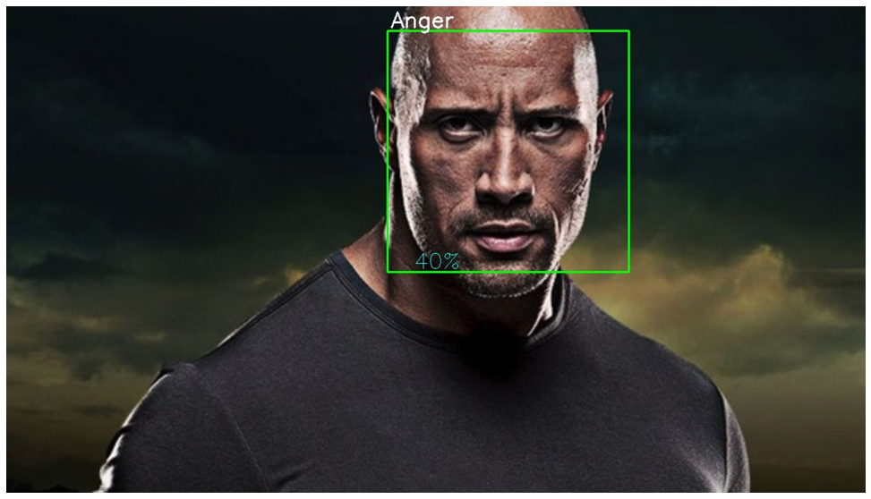
RESULTS

